Slide 1

To Bot or Not To Bot Detecting AI-Generated Fake Personas on Twitter Using Multimodal Transformers
Seyedehsara Mirsepassi
seyedehsara.mirsepassi@studenti.unimi.it
Department of Computer Science, Università degli studi di Milano

Slide 2
Motivation & Objective
Why Detecting Bots Matters
Bots can manipulate public opinion, spread misinformation, and generate spam.
They are hard to detect as they mimic real users using AI-generated content.
Project Objective
Build a multimodal classification model that combines:
Textual data (User’s profile description (bio), username and tweet contents)
Behavioral metadata (Number of followers, followings, tweets and their ratios)
Visual features (User’s profile image)
By combining these diverse types of information, the model aims to learn a richer representation of each user and improve the detection of Bots compared to what can be achieved by analyzing text alone.
Classify each user as either Human (0) or Bot (1)

Slide 3
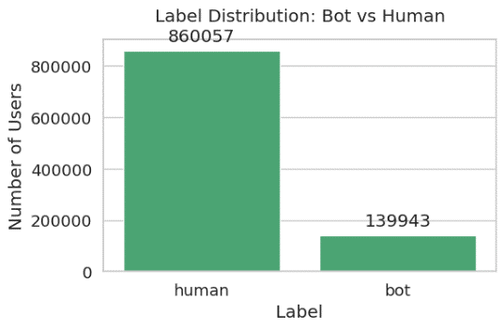
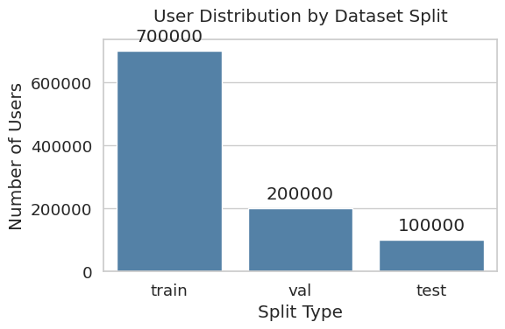
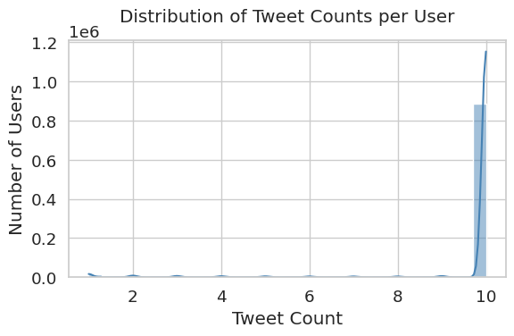
Dataset Overview
TwiBot-22 Dataset
Over 1 million Twitter users with:
user.json: Profile metadata
tweet0-8.json: Up to 10 tweets per user
label.csv: Ground truth (bot/human)
split.csv: Train/Validation/Test sets
Preprocessing Highlights
Filtered users with <10 tweets for meaningful textual analysis
Balanced sample: 50,000 bots + 50,000 humans
Profile images were downloaded and organized to avoid missing data

Slide 4
Initial Data Loading and Preprocessing Challenges
Memory limitations while processing tweet data:
Tweet file volume: Aound 100 GB of data (Each ~11–13 GB)
Tweet file structure: Single large JSON array (not line-delimited) ➔ Incompatible with memory-efficient parsers such as json.load().
Loading the entire content using json.load() ➔ immediately caused RAM crashes in Google Colab.
Solution: A custom streaming generator using ijson
Each tweet was read one-by-one and matched against a predefined list of valid user IDs. If a match was found, the tweet text was saved into memory.
Efficient and reliable image handling:
TwiBot-22 provides paths to profile images.
Downloading images on-demand during model training would have led to frequent failures due to missing URLs, timeouts or internet instability.
Solution: A dedicated preprocessing phase was added to download all valid profile images in advance.
Corrupted or broken images were skipped automatically.

Slide 5
Multimodal Input Features and Processing Models
Multimodal Input Features
Text:
Username, profile bio, up to 10 tweets per user
Processing Model: RoBERTa-base (Transformer)
Tokenizes and encodes text into a 768D vector → Outputs a 256D semantic embedding after projection
Behavioral Data:
Follower/following ratio, Log-transformed tweet, follower, following counts
Processing Model: Custom Feedforward Neural Network
Outputs a 32D normalized behavior embedding
Image:
Profile pictures (if available)
Processing Model: CLIP ViT-B/32 (Transformer Vision Encoder by OpenAI)
Outputs a 512D semantic vector → Projected to 128D image embedding (If missing, a trainable fallback embedding is used)

Slide 6
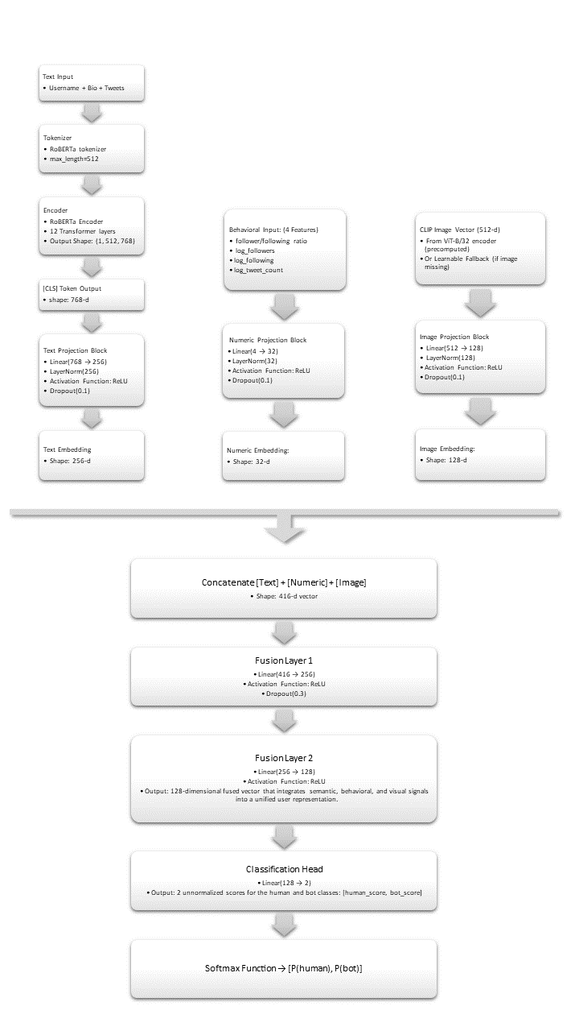
Model Architecture

Slide 7
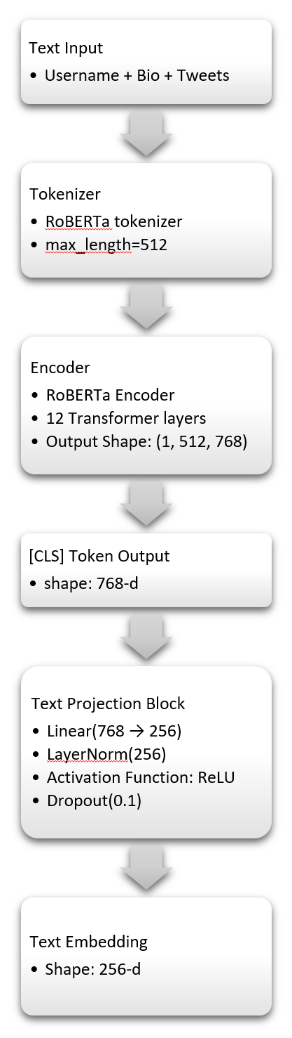
Model Architecture - TexT Encoder
The user’s profile data (username, profile description and tweet) is concatenated into a single long text block.
This input is first passed to the RoBERTa-base tokenizer (Byte-Pair Encoding (BPE)). The output includes a list of token IDs representing the input sentence (max 512 tokens) and a binary list marking real tokens (1) vs padding (0):
input_ids = [0, 1332, 435, 9871, 204, 4, 2, 1, 1, ..., 1] # Length 512
attention_mask = [1, 1, 1, 1, 1, 1, 1, 0, 0, ..., 0]
The tokenized output is then passed to the RoBERTa-base transformer encoder, a pretrained model from Hugging Face consisting of 12 identical transformer layers. Each layer is composed of two key subcomponents:
1. Multi-head Self-Attention Block
Each self-attention block contains 12 parallel attention heads (a single self-attention mechanism) that capture different types of relationships in the text.
2. Feedforward Neural Network (FFN)
A two-layer fully connected network with a hidden size of 3072 and GELU activation. The FFN processes each token representation independently, helping it refine its meaning using the context gathered from attention block.
This sequence of operations is repeated 12 times, once per transformer layer ➔ build deep and rich semantic representations of text:
Output Shape: (batch size=1,512,768)
The first vector “[CLS] token” is extracted and passed through a projection block (Neural Network) to reduce its dimensionality and enhance training stability:
Linear(768 → 256) → LayerNorm → ReLU → Dropout
The result is a 256-dimensional text embedding that captures the semantic and stylistic features of the user’s profile and tweet content.

Slide 8
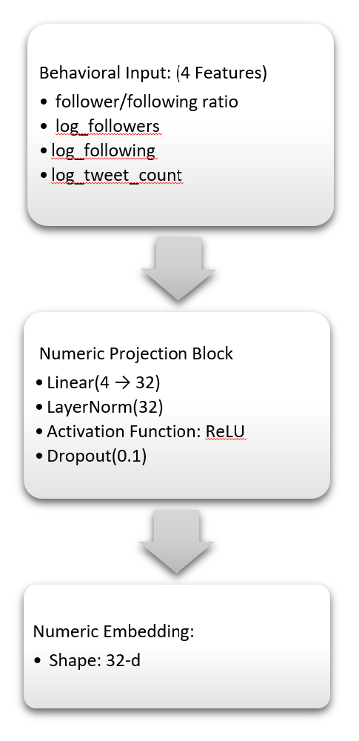
Model Architecture – Behavioral Encoder
From each user’s metadata, four numerical features are computed:
Follower/following ratio
Log of follower count
Log of following count
Log of tweet count
Logarithmic transformation is used to compress large ranges and reduce skewness in distributions.
The resulting 4D feature vector is passed through a dedicated feed-forward projection block:
Linear(4 → 32) → LayerNorm → ReLU → Dropout

Slide 9
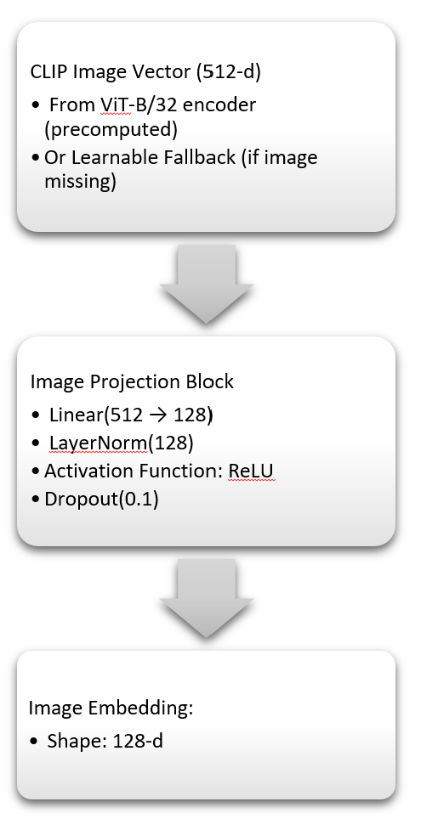
Model Architecture – Image Encoder
Image Handling:
TwiBot-22 provides paths to profile images but does not include precomputed image features.
A dedicated preprocessing phase was added to download all valid profile images in advance.
Each profile image is passed through the CLIP ViT-B/32 image encoder, a pretrained transformer model from OpenAI.
CLIP generates a 512-dimensional vector for each image, capturing abstract concepts like gender cues, image quality, realism and more.
Initially, users without a valid profile image were simply assigned a fixed zero vector of shape "512" like [0, 0, ..., 0] ➔ hard distinction between users with and without images, which could negatively impact the model's generalization.
To address this, the zero vector strategy with a learnable fallback embedding, was replaced — a randomly initialized trainable vector of the same size "512". ➔ This embedding is updated during model training alongside other weights. It adapts based on how users without images behave in combination with text and numeric features. ➔ Better generalization results.
The 512-dimensional image feature is passed through another projection block:
Linear(512 → 128) → LayerNorm → ReLU → Dropout
This results in a 128-dimensional image embedding, providing semantic visual context for the user. ➔ These features were stored in a dictionary by user ID and serialized to a file (clip_features.pt) for quick loading during model training.

Slide 10
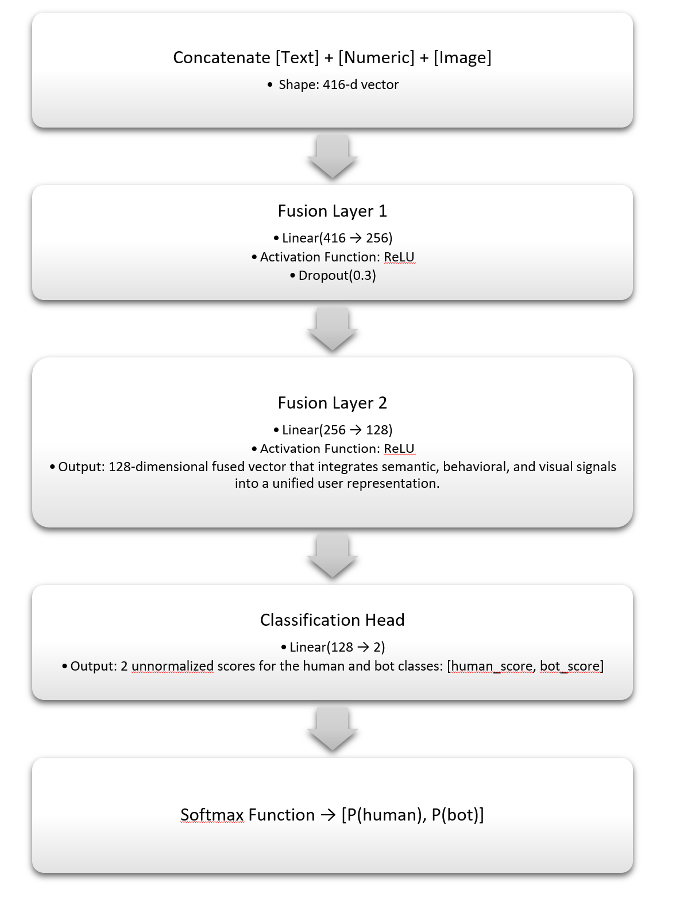
Model Architecture – Fusion Layer
The three embeddings — text (256), numeric (32) and image (128) — are concatenated into a single 416-dimensional feature vector.
This combined vector is passed through two dense layers to mix the information from all input types:
Linear(416 → 256) → ReLU → Dropout(0.3)}
Linear(256 → 128) → ReLU
The output is a 128-dimensional mixed vector that integrates semantic, behavioral and visual signals into a unified user representation.

Slide 11
Model Architecture – Classification Layer
The fused vector is passed to a final dense layer:
This produces two output values, representing the unnormalized scores for the human and bot classes.
A softmax function is applied to convert these scores into class probabilities:
Softmax(logits) → [P(human), P(bot)]
The model selects the class with the highest probability as the final prediction.

Slide 12
Training Configuration
Cross-entropy loss with label smoothing was used as model's primary loss function.
Cross-entropy compares the predicted class probabilities to the true labels and penalizes incorrect predictions more heavily the more confident they are.
Label smoothing slightly softens the target labels (e.g., change 1 to 0.95 and 0 to 0.05) ➔ prevents the model from becoming too confident and helps it generalize better to unseen data.
Focal Loss was also implemented and tested. It modifies cross-entropy to focus more on difficult examples (e.g., users that are frequently misclassified) by down-weighting already well-classified samples.
This was intended to improve recall. However, focal loss caused unstable training and was ultimately not used in the final model due to better and more consistent results from the regular cross-entropy with label smoothing.
RoBERTa was frozen for the first epoch of training. This prevents the pretrained text encoder from being disrupted by random gradients from the newly initialized fusion and projection layers, allowing those newer components to stabilize first.

Slide 13
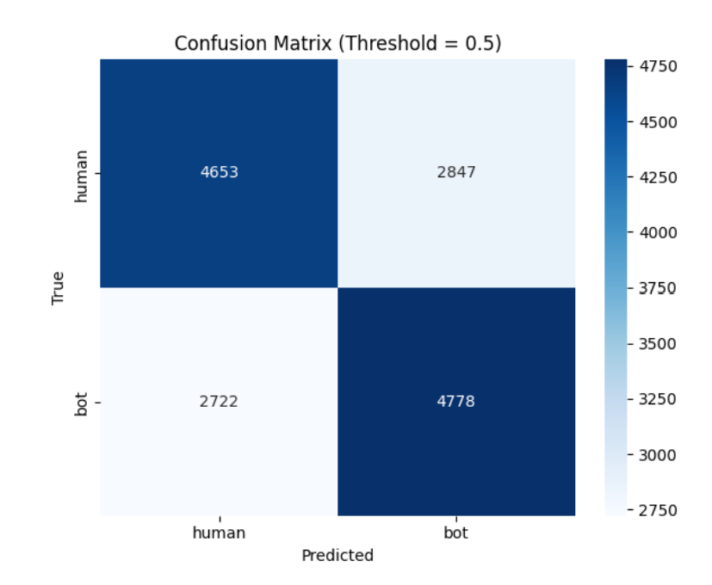
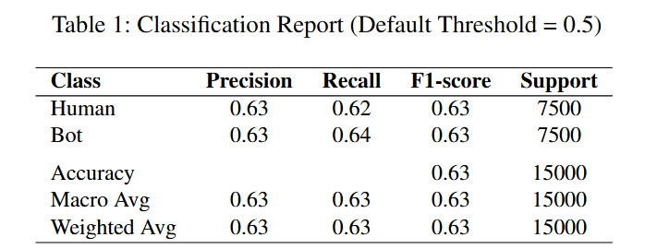
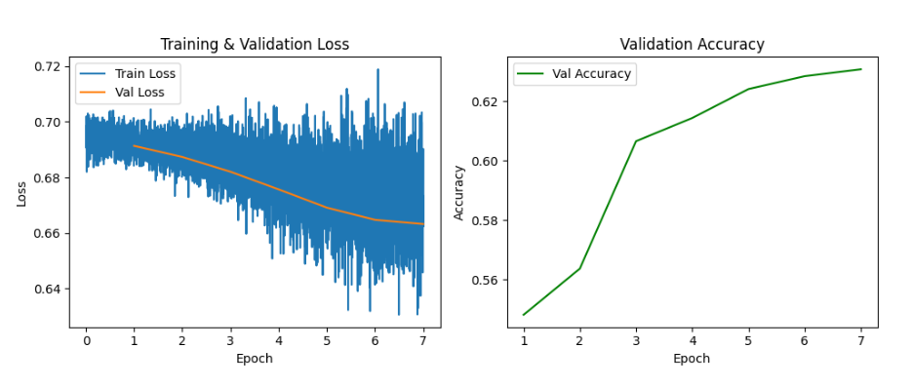
Experimental Results and Threshold Tuning
After training the final multimodal model on a balanced dataset of 100,000 users (50K bots and 50K humans), evaluation was conducted on a 15,000-user test set.
Using the default classification threshold of 0.5 (where the model predicts "bot" if its softmax probability is greater than 0.5), the model achieved a test accuracy of 63%, with a macro F1 score of 0.6287. Precision and recall scores were well-balanced for both classes: 0.63 for human and 0.63–0.64 for bots, suggesting the model could detect both classes with reasonable symmetry.

Slide 14
Conclusion
This project aimed to develop a strong system for detecting bots on Twitter using a multimodal transformer-based model.
The model combines three sources of information: text (from profiles and tweets), behavioral metadata and profile image features.
Development began with a text-only RoBERTa baseline, which reached ~73% F1 score but struggled to consistently identify real users due to high linguistic variability.
To address this, behavioral features—such as follower-following ratio and tweet count—were incorporated, helping the model better recognize inactive or suspicious account patterns.
Visual information was added next using CLIP to encode profile images into semantic vectors. This proved especially helpful for spotting misleading or AI-generated visuals. A learnable fallback embedding handled missing images, improving robustness.
The fusion layer was then redesigned to apply per-modality projections before combining the features. This approach improved both performance and training stability by letting each modality specialize before integration.
The final model achieved a balanced F1 score around 63% and demonstrated flexibility when tested with different classification thresholds, highlighting trade-offs between bot precision and human recall.
These evaluations show the model can be adjusted depending on whether false positives or missed detections are more critical in practice.

Slide 15
Future Work
One potential enhancement is to fine-tune the CLIP image encoder along with the rest of the model, rather than keeping it fixed.
This allows the encoder to be updated during training so it can better learn visual features that help distinguish bots from humans, instead of relying on general-purpose features from a pretrained CLIP model.
While this approach can improve accuracy, it also requires more computing resources and careful tuning to prevent overfitting. Overall, it enables the model to focus more effectively on visual cues relevant to bot detection.
Additionally, the model could be extended by incorporating social graph information, such as who follows or interacts with whom. These network-based features might reveal hidden patterns in bot behavior.
Overall, this project has shown that combining different types of information — text, behavior, and images — leads to a more powerful system. Future work can build on this foundation to handle even more complex and realistic fake profiles.

